Slide 1


Brandon Young
10.10.2023

Slide 2
Executive Summary
Introduction
Methodology
Results
Conclusion
Appendix
Outline

Slide 3
SUMMARY OF METHODOLOGIES
Executive Summary
Data Collection through SpaceX API
Data Collection with Web Scraping
Data Wrangling
EDA with Visualization
EDA with SQL
Building an Interactive Map with Folium
Machine Learning Prediction and Analysis
SUMMARY OF ALL RESULTS
Preliminary analysis based on EDA
Interactive Analytics with screenshots
Machine Learning Predictive analysis results

Slide 4
PROJECT BACKGROUND AND CONTEXT
SpaceX has transformed the space industry with its Falcon 9 rocket by prioritizing reusability to reduce launch costs. According to their website, a Falcon 9 launch costs around $62 million, whereas other providers, including NASA, can charge over $165 million for similar launches. One of the key factors in SpaceX's cost-saving approach is their ability to successfully land and reuse the first stage of the Falcon 9. If a new competitor, such as SpaceY, wants to challenge SpaceX in the market, it is essential to understand the success rate of first-stage landings. This project aims to analyze the available data and use machine learning to predict the success of the Falcon 9’s first-stage landing. Such insights can be invaluable for competitors looking to effectively bid against SpaceX.
Introduction
MATTERS TO EXAMINE
What factors determine if Falcon 9 will land successfully?
How does the success rate of the Falcon 9 landings compare to other rockets?
What features in the data are most influential in predicting successful lands?

Slide 5

Section 1

Slide 6
Executive Summary
Data collection methodology:
Describe how data was collected
Perform data wrangling
Describe how data was processed
Perform exploratory data analysis (EDA) using visualization and SQL
Perform interactive visual analytics using Folium and Plotly Dash
Perform predictive analysis using classification models
How to build, tune, evaluate classification models
DATA COLLECTION METHODOLOGY
Using SpaceX Rest API
Web Scrapping from Wikipedia
Methodology
PERFORM DATA WRANGLING
Data was cleaned and transformed using one-hot encoding for machine learning
PERFORM EDA USING VISUALIZATION AND SQL
Data was queried with SQL and various plots were used to show patterns in the data
PERFORM INTERACTIVE VISUAL ANALYTICS USING FOLIUM AND PLOTLY DASH
Folium was used along with Dash to build interactive maps and a dashboard
PERFORM PREDICTIVE ANALYSIS USING CLASSIFICTION MODELS
Different ML algorithms were used to find the most accurate results on the data.

Slide 7
Data Collection
For data collection, I employed the following methods:
Request and parse the SpaceX launch data using the GET request via the SpaceX Rest API
Web scrape SpaceX’s Wikipedia page for launch data using Beautiful Soup. The objective was to get the necessary tables needed from it.

Slide 8
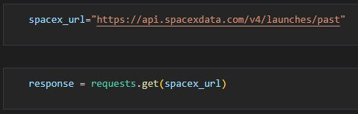
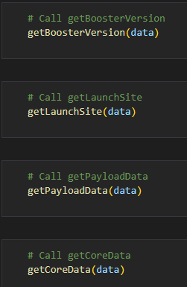
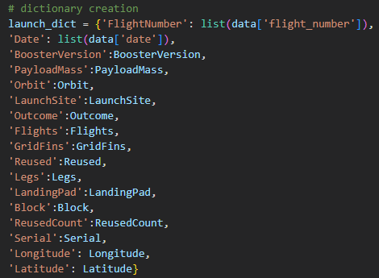
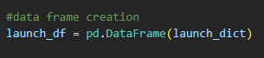
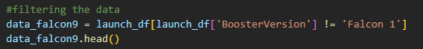
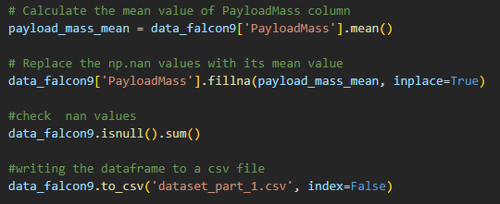
Executive Summary
Data collection methodology:
Describe how data was collected
Perform data wrangling
Describe how data was processed
Perform exploratory data analysis (EDA) using visualization and SQL
Perform interactive visual analytics using Folium and Plotly Dash
Perform predictive analysis using classification models
How to build, tune, evaluate classification models
Data Collection – SpaceX API
I used the get request to SpaceX to collect data and did some light data wrangling
Save data out to CSV file
Link to the completed notebook https://github.com/byvfx/ibm_ds_capstone/blob/main/jupyter-labs-spacex-data-collection-api.ipynb

Slide 9
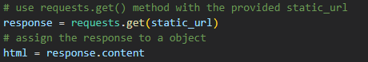
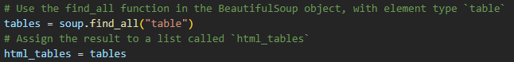
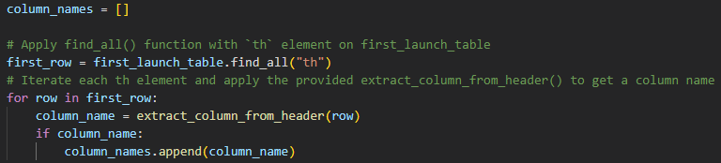
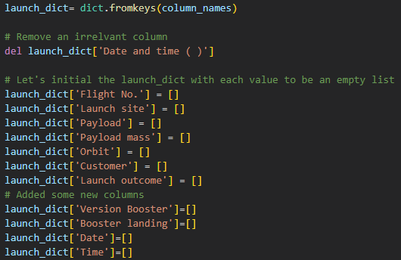
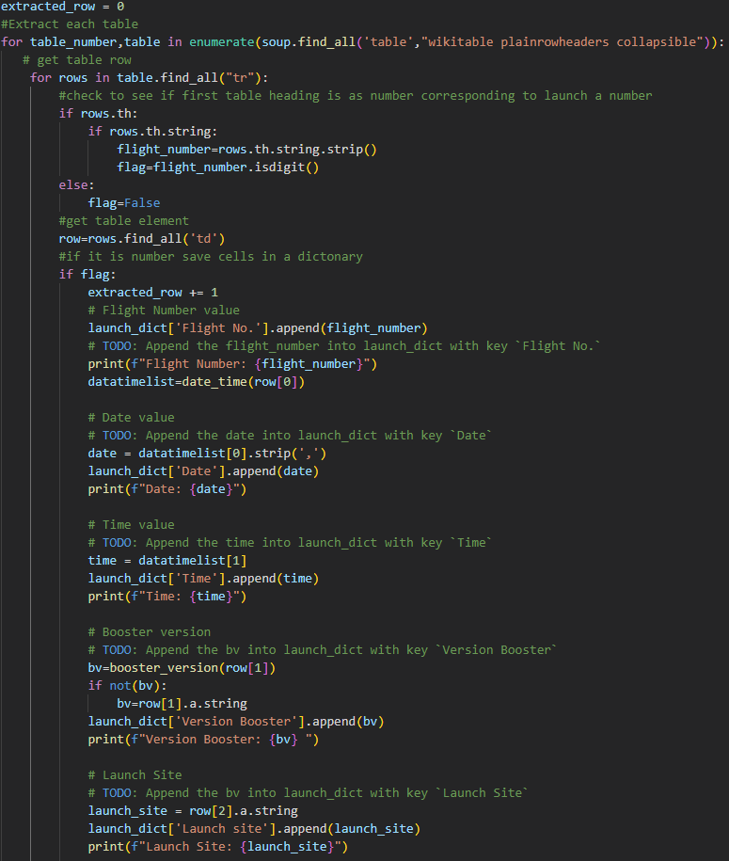
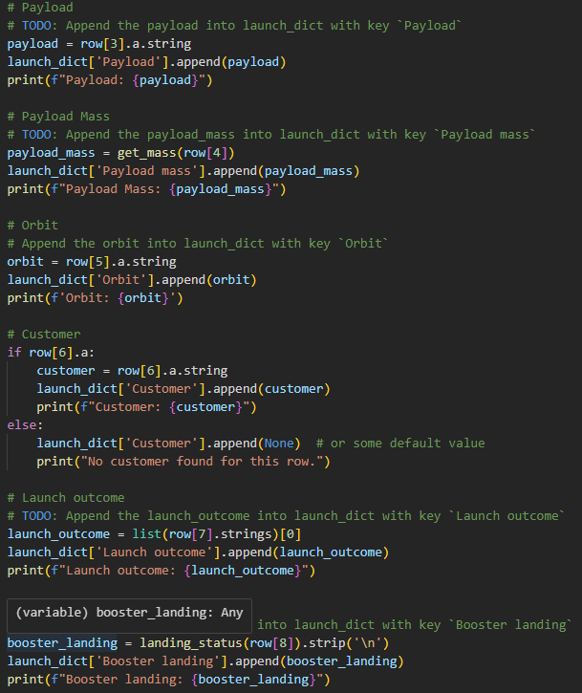
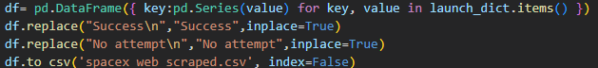
Executive Summary
Data collection methodology:
Describe how data was collected
Perform data wrangling
Describe how data was processed
Perform exploratory data analysis (EDA) using visualization and SQL
Perform interactive visual analytics using Folium and Plotly Dash
Perform predictive analysis using classification models
How to build, tune, evaluate classification models
Data Collection – Scraping
I used Beautiful Soup to scrape the data from Wikipedia
Extracted all column/variable names from the HTML table header
Created a data frame by parsing the launch HTML tables
Save data to a CSV file
Link to the completed notebook https://github.com/byvfx/ibm_ds_capstone/blob/main/jupyter-labs-webscraping.ipynb

Slide 10
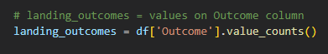
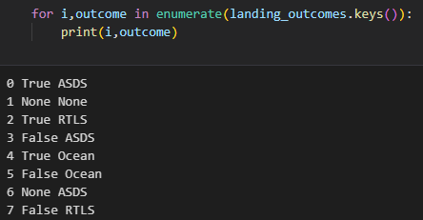
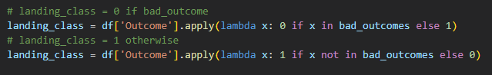
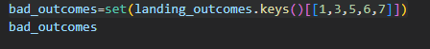
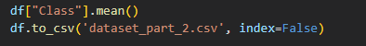
Executive Summary
Data collection methodology:
Describe how data was collected
Perform data wrangling
Describe how data was processed
Perform exploratory data analysis (EDA) using visualization and SQL
Perform interactive visual analytics using Folium and Plotly Dash
Perform predictive analysis using classification models
How to build, tune, evaluate classification models
Data Wrangling
With the data from the SpaceX API I needed to do the following:
Calculate the number of launches on each site
Calculate the number and occurrence of each orbit
Calculate the number and occurrence of mission outcome of the orbits
Create a landing outcome label from the ‘Outcome’ column, classifying it as successful or failure.
Save data to a CSV file
Link to the completed notebook https://github.com/byvfx/ibm_ds_capstone/blob/main/labs-jupyter-spacex-Data%20wrangling.ipynb

Slide 11
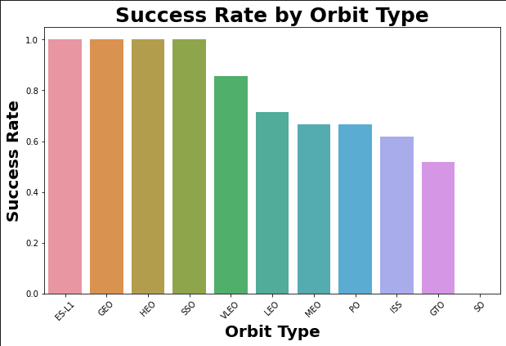
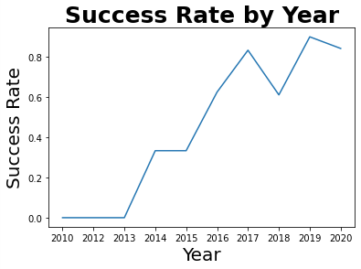
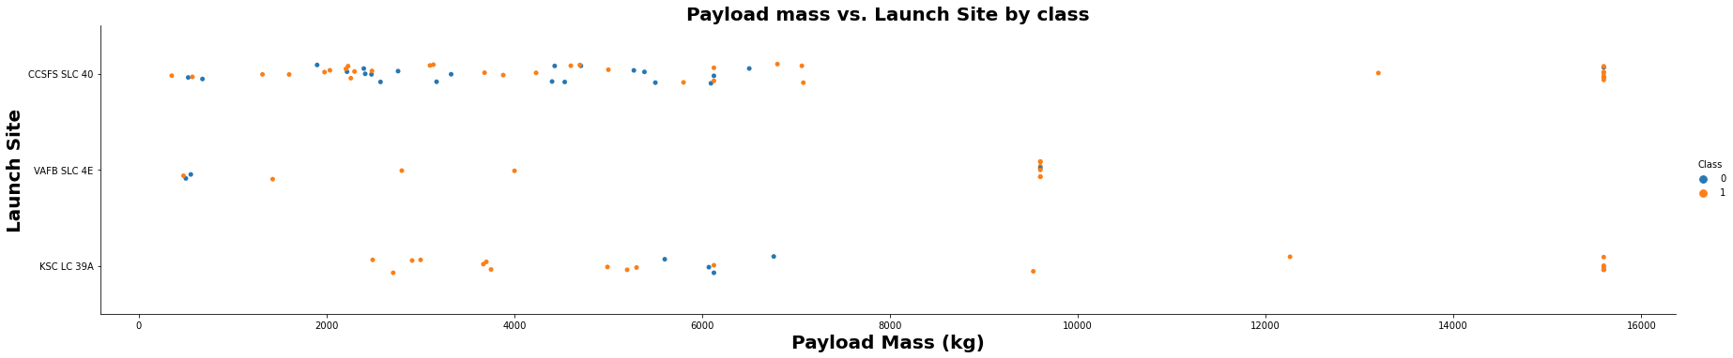
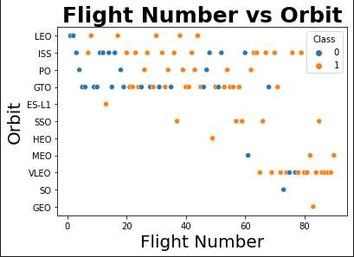
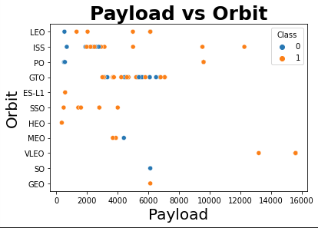
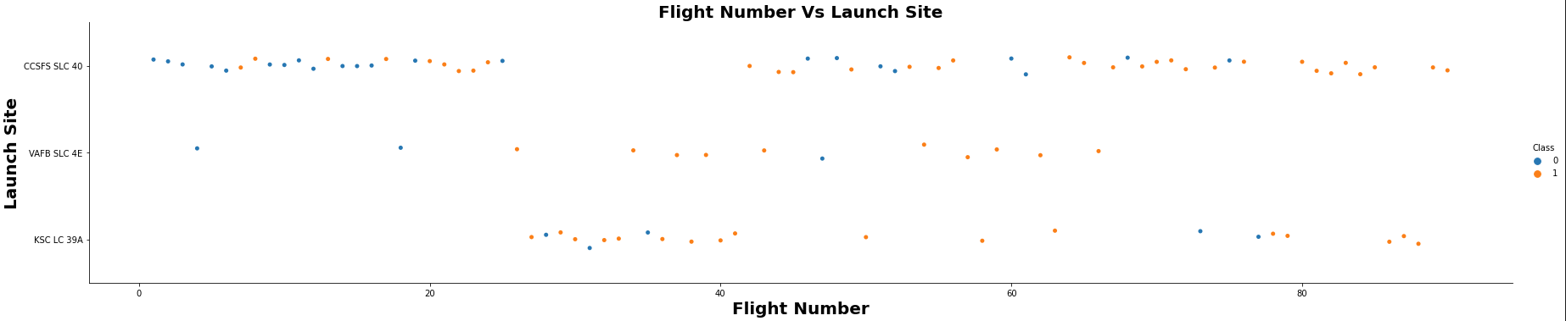
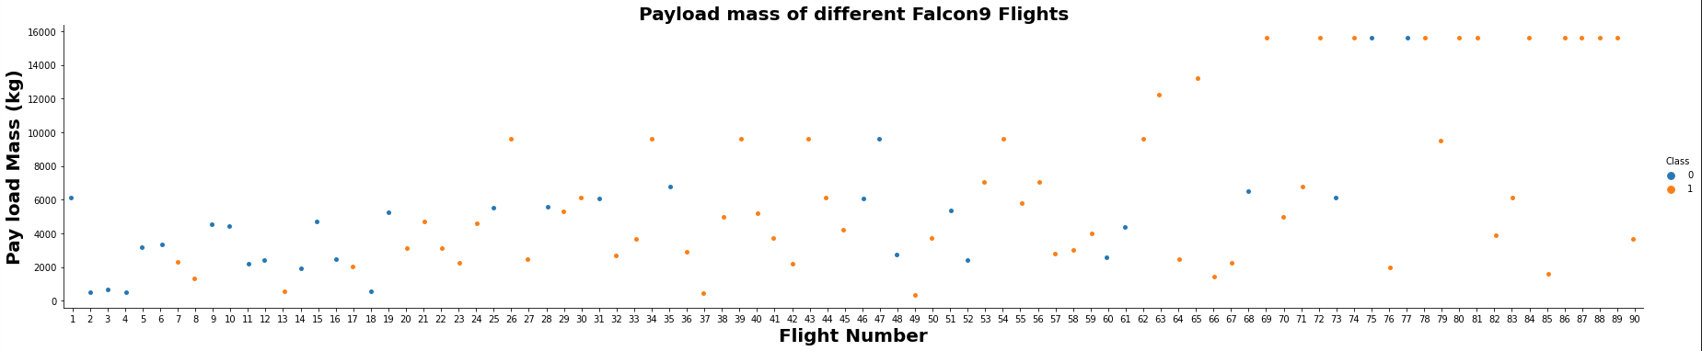
Executive Summary
Data collection methodology:
Describe how data was collected
Perform data wrangling
Describe how data was processed
Perform exploratory data analysis (EDA) using visualization and SQL
Perform interactive visual analytics using Folium and Plotly Dash
Perform predictive analysis using classification models
How to build, tune, evaluate classification models
EDA with Data Visualization
I explored the data relationship between flight number, launch site, payload and success rate of each orbit type, and the launch success yearly trend.
Link to the completed notebook https://github.com/byvfx/ibm_ds_capstone/blob/main/jupyter-labs-eda-dataviz.ipynb

Slide 12
Executive Summary
Data collection methodology:
Describe how data was collected
Perform data wrangling
Describe how data was processed
Perform exploratory data analysis (EDA) using visualization and SQL
Perform interactive visual analytics using Folium and Plotly Dash
Perform predictive analysis using classification models
How to build, tune, evaluate classification models
SQL QUERIES PERFORMED
Display the names of the unique launch sites in the space mission
Display 5 records where launch sites begin with the string 'CCA'
Display the total payload mass carried by boosters launched by NASA (CRS)
Display average payload mass carried by booster version F9 v1.1
List the date when the first successful landing outcome in the ground pad was achieved.
List the total number of successful and failed mission outcomes
List the names of the booster_versions which have carried the maximum payload mass. Use a subquery
List the records which will display the month names, failure landing_outcomes in drone ship ,booster versions, launch_site for the months in year 2015
Rank the count of landing outcomes (such as Failure (drone ship) or Success (ground pad)) between the date 2010-06-04 and 2017-03-20, in descending order
EDA with SQL
Link to the completed notebook https://github.com/byvfx/ibm_ds_capstone/blob/main/jupyter-labs-eda-sql-coursera_sqllite.ipynb

Slide 13
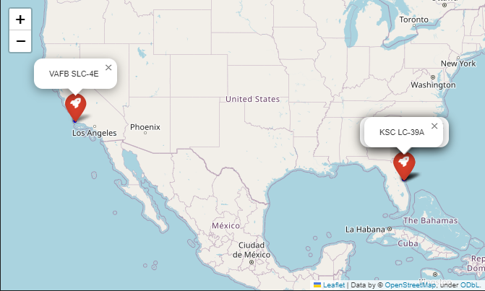
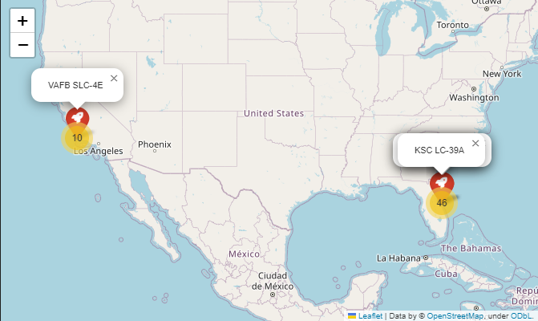
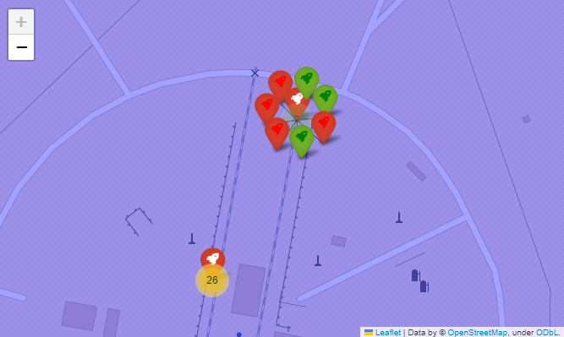
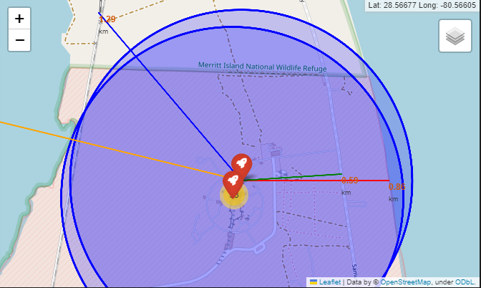
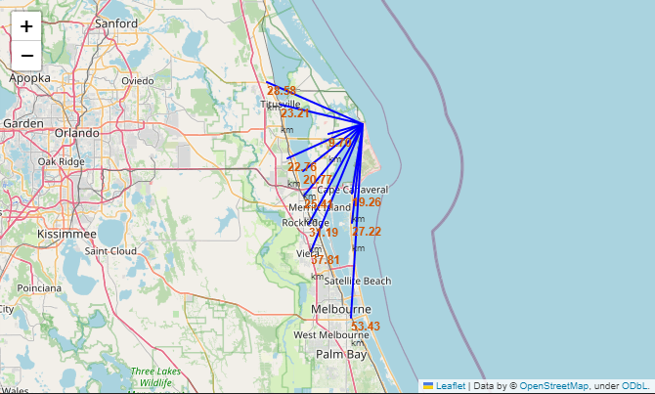
Executive Summary
Data collection methodology:
Describe how data was collected
Perform data wrangling
Describe how data was processed
Perform exploratory data analysis (EDA) using visualization and SQL
Perform interactive visual analytics using Folium and Plotly Dash
Perform predictive analysis using classification models
How to build, tune, evaluate classification models
Build an Interactive Map with Folium
We marked where rockets launch on a map.
We used different symbols on the map to show whether a rocket launch was successful.
We gave each launch a label: 0 means it failed, and 1 means it was successful.
We grouped launch sites by color to see which ones succeed more often.
We looked at launch sites’ proximity to things like train tracks, roads, and the ocean.
We checked if the launch sites are far from cities.
Link to the completed notebook https://github.com/byvfx/ibm_ds_capstone/blob/main/lab_jupyter_launch_site_location.ipynb

Slide 14
Executive Summary
Data collection methodology:
Describe how data was collected
Perform data wrangling
Describe how data was processed
Perform exploratory data analysis (EDA) using visualization and SQL
Perform interactive visual analytics using Folium and Plotly Dash
Perform predictive analysis using classification models
How to build, tune, evaluate classification models
PIE CHART
It shows the success rate of all launch sites.
It displays the proportion of success and failures of given launch site.
Build a dashboard with plotly dash
SCATTER PLOT
It shows the correlation between mission outcome and payload mass for different booster versions for all sites or selected site.
The payload mass can be filter by weight range using the slider control.
Link to the completed notebook https://github.com/byvfx/ibm_ds_capstone/blob/main/dash_spacex_lab.py

Slide 15
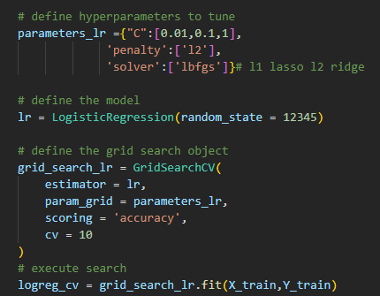
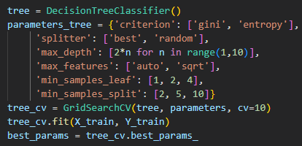
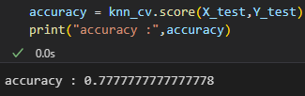
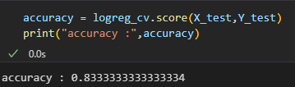
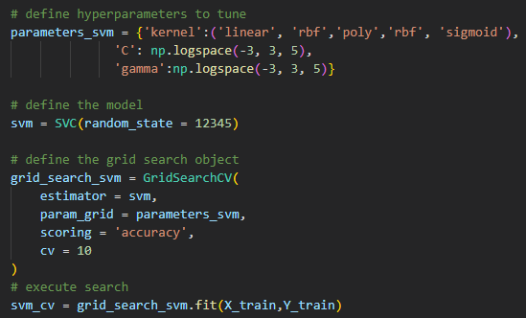
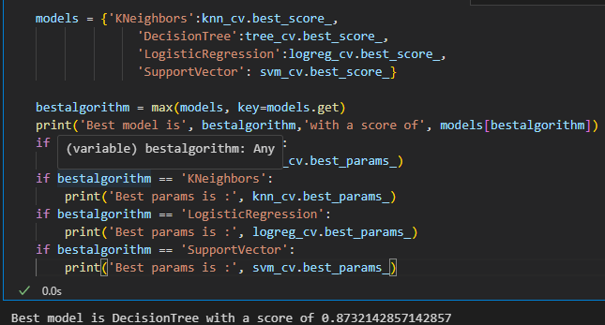
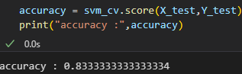
Predictive Analysis (Classification)
I loaded in the data using numpy and pandas, transformed the data, split out data into training and testing.
I built different machine-learning models and tuned different hyperparameters using GridSearch CV.
I used accuracy as the metric for our model improved the model using feature engineering and algorithm tuning.
I found the best-performing classification model. Which was the decision tree
Link to the completed notebook https://github.com/byvfx/ibm_ds_capstone/blob/main/SpaceX_Machine_Learning_Prediction_Part_5.jupyterlite.ipynb

Slide 16
Results
Exploratory data analysis results
Interactive analytics demo in screenshots
Predictive analysis results

Slide 17

Section 2

Slide 18
Flight Number vs. Launch Site
More recent missions have higher success rates at all launch sites
There's an apparent trend where certain launch sites are more commonly used during specific flight number ranges.
There seems to be a transition from more Class 0 flights to more Class 1 flights as the flight numbers increase.

Slide 19
Payload vs. Launch Site
There isn't a strong linear correlation between payload mass and launch success or failure for individual launch sites based on the visual inspection.
All launch sites have both successful and unsuccessful launches (Class 0 and Class 1) across various payload masses.

Slide 20
Payload vs. Launch Site
There isn't a strong linear correlation between payload mass and launch success or failure for individual launch sites based on the visual inspection.
All launch sites have both successful and unsuccessful launches (Class 0 and Class 1) across various payload masses.

Slide 21
Success Rate vs Orbit Type
The chart shows different orbit types have varying levels of launch success rates, with ESI-L1 and GEO achieving almost perfect success, while SSO orbits experience the least success.

Slide 22
Flight Number vs. Orbit
Orbit types like LEO and ISS have a higher frequency of launches across a broad range of flight numbers, while others like HEO, SO, and GEO have fewer launches.

Slide 23
Payload vs. Orbit Type
Some orbit types, like LEO and ISS, mainly deal with lighter payloads, while others, like MEO, handle heavier ones. Both success and failure outcomes are present across the different payload ranges for various orbits.

Slide 24
Launch Success Yearly Trend
Over the years we can see that the success rate has steadily climbed

Slide 25
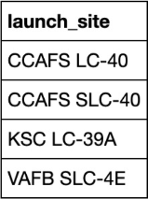
All Launch Site Names
SQL Query
"SELECT DISTINCT Launch_Site FROM SPACEXTBL;
Query Result
Explanation
We are looking for names with unique launch site names in the Spacex table
Using select distinct statement to retrieve the unique launch site names

Slide 26
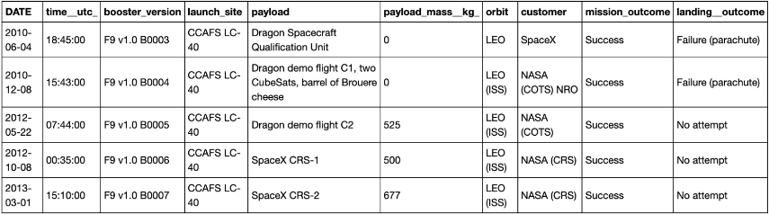
Launch Site Names Begin with 'CCA'
SQL Query
SELECT * FROM SPACEXTBL
WHERE Launch_Site
LIKE 'CCA%’ limit 5;
Query Result
Explanation
We are looking for records that begin with CCA with a limit of 5
Using the like operator to search a specific pattern and using the limit clause to retrieve on 5 records

Slide 27
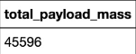
Total Payload Mass
SQL Query
SELECT Customer, SUM(PAYLOAD_MASS__KG_)
FROM SPACEXTBL
WHERE Customer = 'NASA (CRS)';
Query Result
Explanation
We are looking for the total payload mass carried by the booster launched by NASA (CRS)
Using the sum function to return the total and then using the condition customer = NASA CRS to filter the records

Slide 28
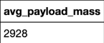
Average Payload Mass by F9 v1.1
SQL Query
SELECT Booster_Version, AVG(PAYLOAD_MASS__KG_)
AS avg_payload_mass
FROM SPACEXTBL
WHERE Booster_Version = 'F9 v1.1';
Query Result
Explanation
We are looking for the average payload mass of the F9 v1.1 rocket
Using the avg function to return the mean and then using the condition booster_version = F9 v1.1 to filter the records

Slide 29
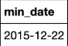
First Successful Ground Landing Date
SQL Query
SELECT MIN(Date)
FROM SPACEXTBL
WHERE Landing_Outcome = 'Success (ground pad)';
Query Result
Explanation
We are looking for the first occurrence of a successful landing on the ground pan
Using the min function to return the first date and then using the condition Landing_Outcome = Success (ground pad) to filter the records

Slide 30
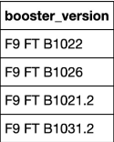
Successful Drone Ship Landing with Payload between 4000 and 6000
SQL Query
SELECT Booster_Version
FROM SPACEXTBL
WHERE Landing_Outcome = 'Success (drone ship)'
AND PAYLOAD_MASS__KG_ > 4000
AND PAYLOAD_MASS__KG_ < 6000;
Query Result
Explanation
We are looking for the names of boosters that have success in drone ship and have a payload mass more significant than 4000 but less than 6000
Using the condition Landing_Outcome = ‘Success (drone ship)’ to filter the records by landing outcome
Using the condition payload_mass_kg_> 4000 and payload_mass_kg_ < 6000 to filter the records by payload mass

Slide 31
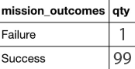
Total Number of Successful and Failure Mission Outcomes
SQL Query
SELECT
CASE
WHEN Mission_Outcome LIKE 'Success%' THEN 'Success'
ELSE 'Failure'
END AS Outcome,
COUNT(*) AS Total
FROM SPACEXTBL
WHERE Mission_Outcome IN (
'Success',
'Success (drone ship)',
'Success (payload status unclear)',
'Failure (in flight)'
)
GROUP BY Outcome;
;
Query Result
Explanation
We are looking for the total number of successful and failure mission outcomes
Using the count(*) statement to retrieve the number of records
Using group by statement to group records by missions outcomes

Slide 32
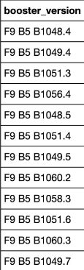
Boosters Carried Maximum Payload
SQL Query
SELECT Booster_Version
FROM SPACEXTBL
WHERE PAYLOAD_MASS__KG_ = (
SELECT MAX(PAYLOAD_MASS__KG_)
FROM SPACEXTBL
);
Query Result
Explanation
We are looking for the names of booster version which have carried the maximum payload mass
Using the subquery to get maximum payload mass
Using the max() function to return the largest value of payload mass

Slide 33
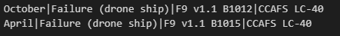
2015 Launch Records
SQL Query
SELECT
CASE
WHEN substr(Date, 6, 2) = '01' THEN 'January'
WHEN substr(Date, 6, 2) = '02' THEN 'February'
WHEN substr(Date, 6, 2) = '03' THEN 'March'
WHEN substr(Date, 6, 2) = '04' THEN 'April'
WHEN substr(Date, 6, 2) = '05' THEN 'May'
WHEN substr(Date, 6, 2) = '06' THEN 'June'
WHEN substr(Date, 6, 2) = '07' THEN 'July'
WHEN substr(Date, 6, 2) = '08' THEN 'August'
WHEN substr(Date, 6, 2) = '09' THEN 'September'
WHEN substr(Date, 6, 2) = '10' THEN 'October'
WHEN substr(Date, 6, 2) = '11' THEN 'November'
WHEN substr(Date, 6, 2) = '12' THEN 'December'
END AS MonthName,
Landing_Outcome AS FailureLandingOutcome,
Booster_Version,
Launch_Site
FROM SPACEXTBL
WHERE substr(Date, 1, 4) = '2015'
AND Landing_Outcome LIKE '%Failure (drone ship)%';
Query Result
Explanation
We are looking for the failed landing outcomes in droneship, their booster versions, and launch site names for the year 2015
Using the substr function to convert the months
Then I filtered the outcome with the LIKE clause for Failure (drone ship)

Slide 34
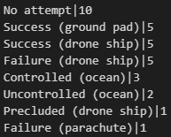
Rank Landing Outcomes Between 2010-06-04 and 2017-03-20
SQL Query
SELECT Landing_Outcome, COUNT(*) AS OutcomeCount
FROM SPACEXTBL
WHERE Date BETWEEN '2010-06-04' AND '2017-03-20'
GROUP BY Landing_Outcome
ORDER BY OutcomeCount DESC;
Query Result
Explanation
We are ranking the count of landing outcomes between the date 2010-06-04 and 2017-03-20
Using the group by statement to group records by landing outcomes
Using order by 2 desc keyword to sort by 2nd column in descending order

Slide 35

Section 3

Slide 36
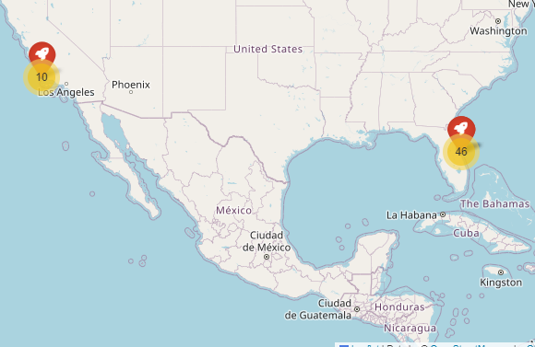
SpaceX Launch Sites Visualization with Folium
All launch sites are far away from cities and near the coast to minimize risk
Launch sites are closer to the equator the Earth's surface near the equator is moving at a higher rotational speed than areas near the poles. This increased speed provides rockets an initial velocity boost, making reaching orbit easier and more energy-efficient. This effect is due to the rotation of the Earth, which is fastest at the equator.

Slide 37
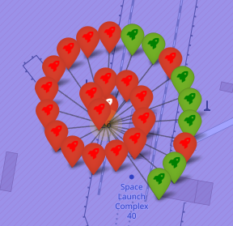
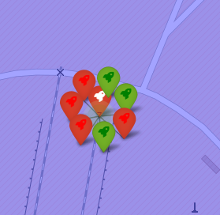


SpaceX Launch Sites Success and Failure using Folium
CCAFS LC-40
CCAFS SLC-40
Green marker: successful landing
Red marker: failed landing
KSC LC-39A has the highest success rate
VAFB SLC-4E
KSC LC-39A

Slide 38


SpaceX Launch Sites Proximity to Cities and other Features
CCAFS SLC-40 launch is relatively positioned far enough away from populated areas. The closest being the Town of Cape Canaveral, 19.26 km away. This minimizes any risks in the event of an accident.

Slide 39

Section 4

Slide 40

Showing Percentages of Successful Launches in Dashboard
KSC LC 39A has the most successful launches
CCAFS SLC-40 has most failures the

Slide 41

Showing Percentages of Successful Launches in Dashboard
KSC LC 39A has the highest ratio of successful launches

Slide 42



Dashboard Payload vs Launch Outcome for all site
B4 stands out as the most versatile booster, capable of handling a wide range of payloads, from very light to heavy (up to 10,000 kg), and maintaining a high success rate.
Other booster versions, such as **B5, FT, v1.0, and v1.1**, have been used for varying payload masses but seem more concentrated in the 0 to 6,000 kg range.
All booster versions consistently exhibit a high success rate across different payload masses, indicating reliable performance.
While present in the higher payload range, the FT booster does not handle payloads as heavy as the B4.
None of the other booster versions (except B4) are shown to manage the heaviest payloads (close to 10,000 kg).
In summary, while all booster versions demonstrate reliable performance across different payload masses, the B4 booster stands out in terms of versatility and capability to manage a broader spectrum of payloads, including the heaviest ones.

Slide 43

Section 5

Slide 44


Classification Accuracy
All models have similar accuracy. The Decision Tree performs the best with a score of .876786

Slide 45

Confusion Matrix
The model of the Decision Tree correctly predicted 15 out of 18 events.
The model made 3 incorrect predictions (false negatives).
The accuracy of the model can be calculated as (TP + TN) / (TP + TN + FP + FN) = (12 + 3) / 18 = 15/18 = 0.8333 or 83.33%.

Slide 46
Conclusions
Trend Analysis:
SpaceX has been riding a wave of success over the past few years. The data indicates a consistent upward trajectory in their launch successes, reflecting technology, processes, and expertise improvements.
Orbital Landings:
A significant achievement has been successfully landing all first stages of rockets designated for ES-L1, GEO, HEO, and SSO orbits. This showcases SpaceX's reusable rocket technology's efficiency and reliability across various mission types.
Versatility of the B4 Booster:
The B4 booster has proven to be a workhorse for SpaceX. Its adaptability is noteworthy, with the capability to handle a vast spectrum of payloads. Whether it's light cargo or heavy equipment weighing up to 10,000 kg, the B4 maintains a commendable success rate, highlighting its engineering excellence.
Launch Site Success Rates:
Among all the launch sites SpaceX uses, the KSC LC-39A has the highest success rate. This could be attributed to multiple factors such as location advantages, infrastructure, or the specific missions launched from this site.
Machine Learning Insights:
After analyzing various algorithms for predicting the success of a landing, the Decision Tree classifier emerged as the best fit. This suggests that the decision-making process for landings has identifiable patterns and rules, which the Decision Tree algorithm can effectively map out.

Slide 47

Appendix
Include any relevant assets like Python code snippets, SQL queries, charts, Notebook outputs, or data sets that you may have created during this project

Slide 48


